Slide 1
MANAGING MOSQUITOES, WATER HYACINTH, DEBRIS, SEWAGE SLUDGE & BLOCKED DRAINS
25 July 2019
Almitra H Patel, Member Supreme Court Committee for Solid Waste Management
National Expert, Swachh Bharat Mission
almitrapatel@rediffmail.com www.almitrapatel.com
YouTube : Almitra Patel

Slide 2
Mosquitoes breed in stagnant water, not in flowing water
In nature, frogs, dragonflies, bats and birds eat
flying mosquitoes. Gambusia fish eat larvae in ponds
Avoid stagnant water around hand-pumps
Keep garbage out of drains, keep them flowing
Add a few drops of kerosene or diesel oil onto the surface of stagnant pockets of water so larvae cannot come up to breathe.
ALL should do this on the SAME DAY if possible.

Slide 3
Mosquitoes can breed even in a teaspoon of stagnant water!
Remove all such stagnant water spots in weekly or monthly campaigns:
Keep empty flowerpots upside down
Keep water out of old tyres, tins, drums
Cut tender-coconut shells into FOUR PIECES

Slide 4
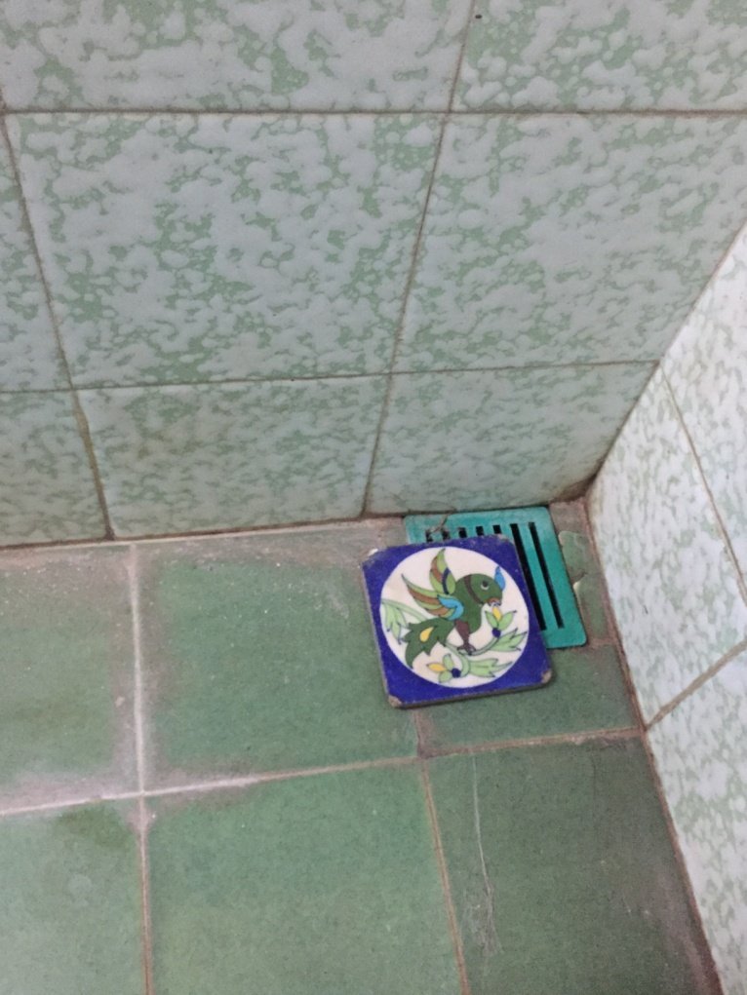
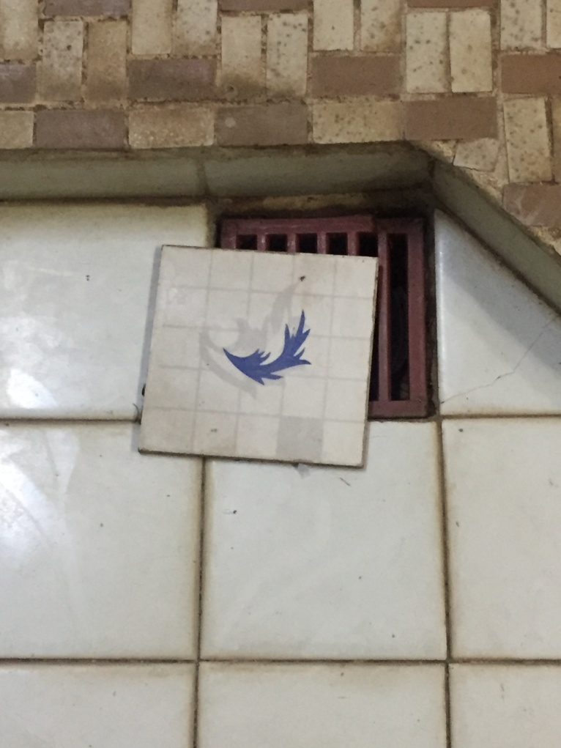
Cover all bathroom gully-traps with a small 4” x 4” tile. Slide it open only while bathing or washing

Slide 5
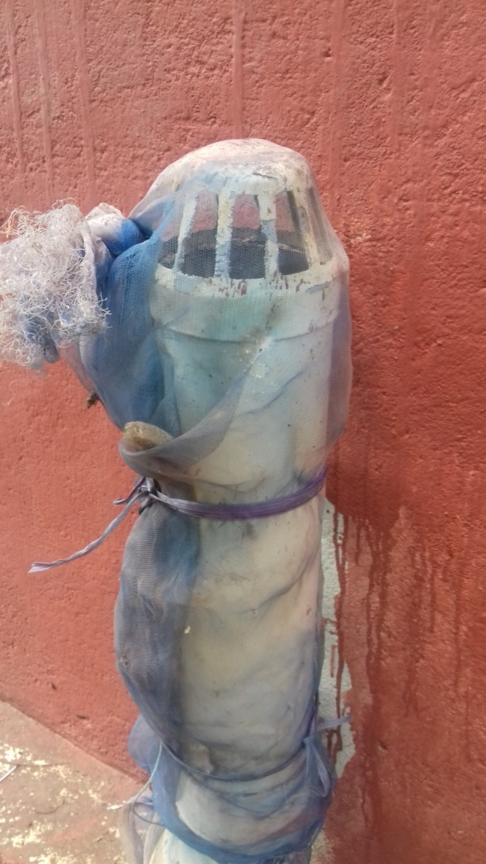
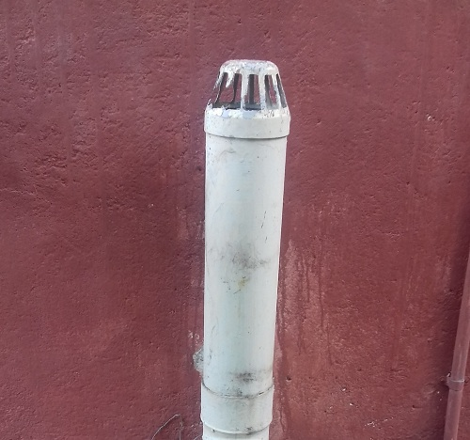
Tie mosquito-netting over the tops of all septic-tank vent pipes. Pune city ward offices sold nets to all.

Slide 6
Keep mosquitoes out of homes
Fix mosquito netting over all windows, ventilators and exhaust fan openings.
Door-closers on outer doors, even with bicycle- springs.
STATES SHOULD LOBBY HEALTH MINISTRY TO ALLOW RETAIL SALE TO PUBLIC OF MEDICATED MOSQUITO NETTING.
2 producers in Karur (e.g.Duranet from Shobikaa) can only export or sell ready-stitched bed-nets to our Health Ministry ! ! WHY?
LLIN medicated netting hung as door and window curtains is more effective all day than a bed-net. Especially since Dengue mosquitoes bite in daytime !

Slide 7
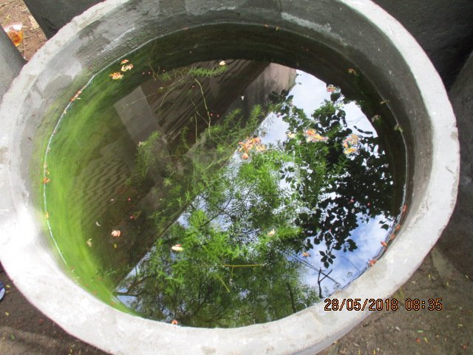
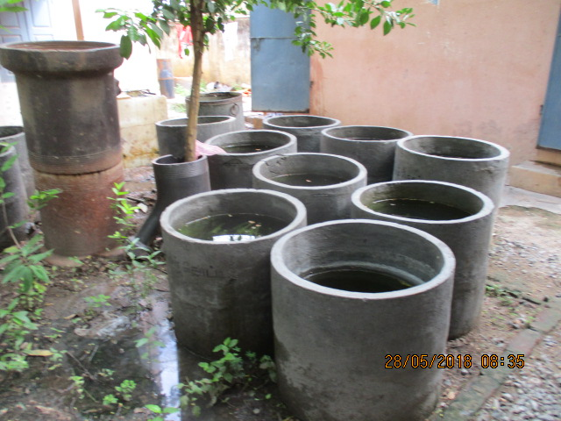
Tiny gambusia fish eat mosquito larvae. Breed them as in Madurai.

Slide 8
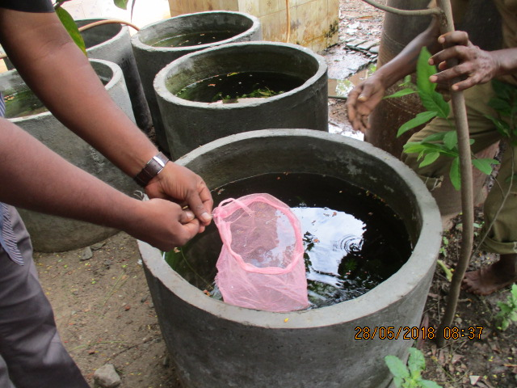
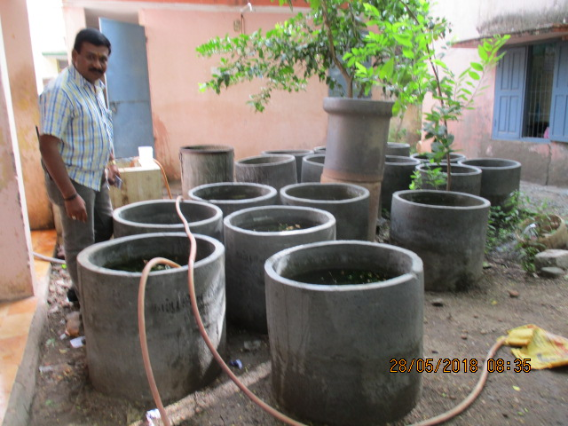
Scoop gambusia in nets to give citizens for release into sump tanks or drains

Slide 9
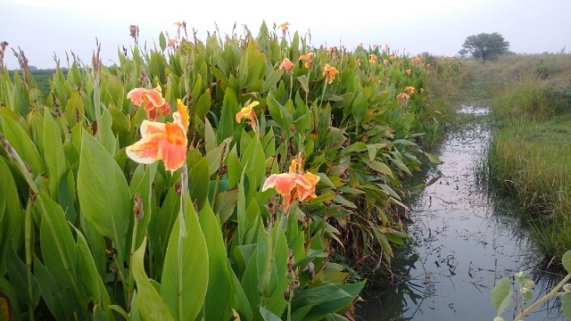
Canna plant roots can grow even in water-logged soil and dry it up

Slide 10
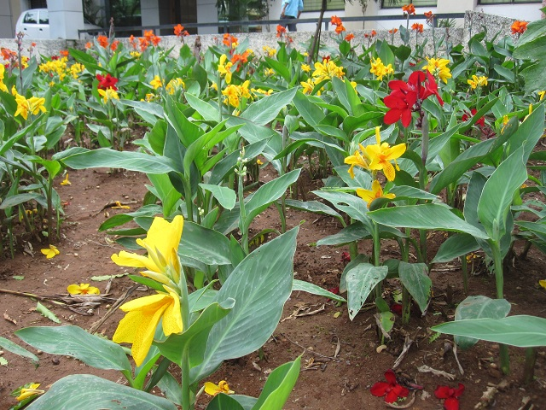
For soak-pit or septic tank overflows:
Plant two rows of cannas.
Leave surplus
waste-water into
each channel on
alternate days to
allow air into soil
and speed up growth
and nitrogen removal.

Slide 11
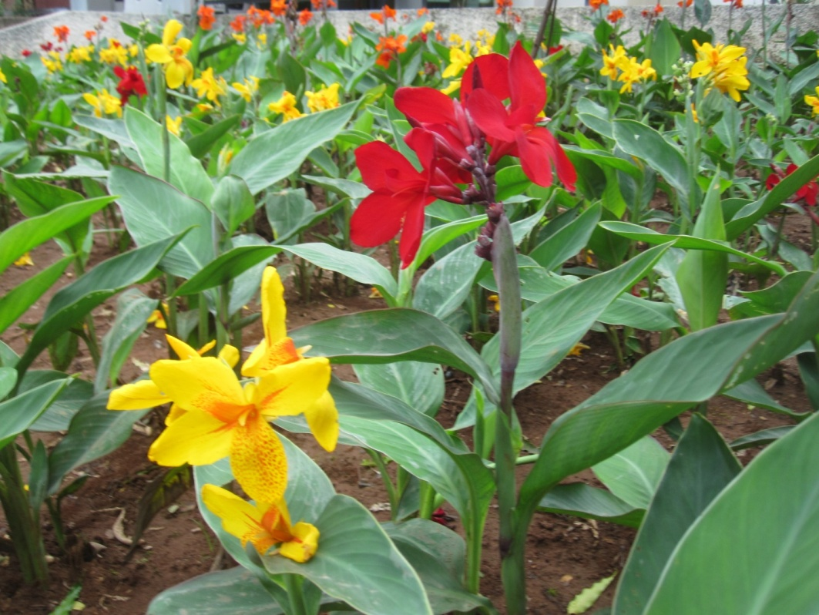
Use waste-water for sub-surface drip irrigation and water treatment
In a long 6-inch PVC pipe make
half-inch holes in the lower
side at 8 inch intervals.
Bury the pipe ~8 inches below
ground level from Soak-pit
outlet to discharge point and
grow cannas all along the pipe.
That reduces wastewater
quantity & removes Nitrogen
from surplus water flowing
out at the end of the pipe.
Cut and harvest the canna
plants annually for fresh
growth and cleaner water.

Slide 12
Waste-water flowing into lakes and rivers is rich fertiliser for water-weeds like water-hyacinth which attract and promote mosquito breeding
Phosphorus ( P ) from detergents is the most active growth-promoter for all water plants.
Limit free phosphorus in all detergents
to 2.2% as USA and Canada did in 1973 to save
Lake Erie. (Google it). EU followed.
Immediately, let every State or at least a major District
Insist on P-content labelling on all
detergents, for the public to make eco-friendly
purchase choices to preserve all their water-bodies.

Slide 13
DEBRIS PILES BREED MOSQUITOES !
Piles of construction and demolition (C & D)
waste breed more mosquitoes than garbage heaps!
Debris remains uncleared for months or years.
Rainwater fills the air pockets within the debris.
Mosquitoes find deep tiny water pockets in debris which fogging cannot reach.
Follow C & D Waste Management Rules 2016.
Have MONTHLY DEBRIS CLEARANCE DRIVES !

Slide 14
Make biogas from your waste-water and sewage plus food wastes as
Kochi homes and convents do.
They get 2 hours cooking gas per home.
Contact Jose Joseph 94470 33360 or
Joseph J Moonjely 94465 23365
josejoseph@cleancity.in

Slide 15
Removing sludge from septic tanks is messy, unhygienic and COSTLY.
Its treatment and disposal is a big problem
MINIMISE and REDUCE sludge formation instead
STOP USING PHENYLE AND BLEACH !
Do not kill the friendly microbes in your septic
tank that digest all solid waste into liquid waste.
Use herbal sanitisers or a tablespoon of liquid
hand-soap in a bucket of cleaning water or for toilets.

Slide 16
Drain blockage is also a huge problem, caused by silt + sani-waste
Blocked underground drains kill the people who
are asked to clean them by diving into filth.
Now a “Bandicoot” robot can replace manual
scavengers and clear drains quickly and safely.
It is an award-winning Trivandrum innovation by
Vimal Govind, now working in six States.
See www.genrobotics.org 98956 89330
Get sanitary napkin firms to donate these robots as their EPR = Extended Producer Responsibility.

